Slide 1

Weekly Report

Slide 2
Progress 16 November 2020 – 22 Desember 2020
Melanjutkan coding bagian aplikasi
Instagram

Slide 3
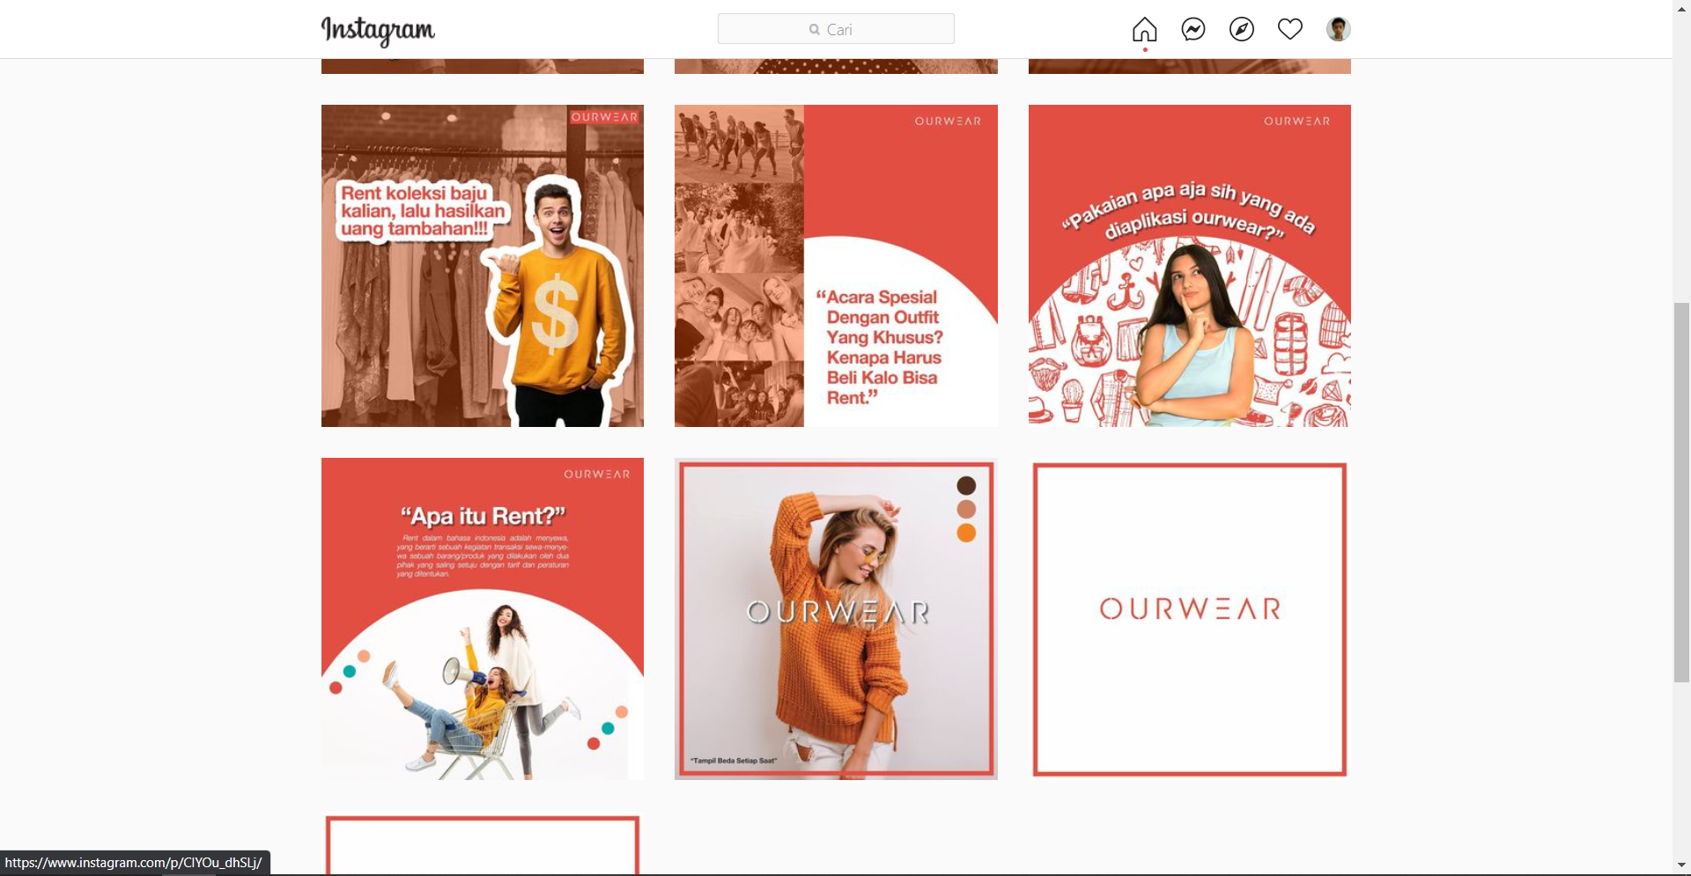
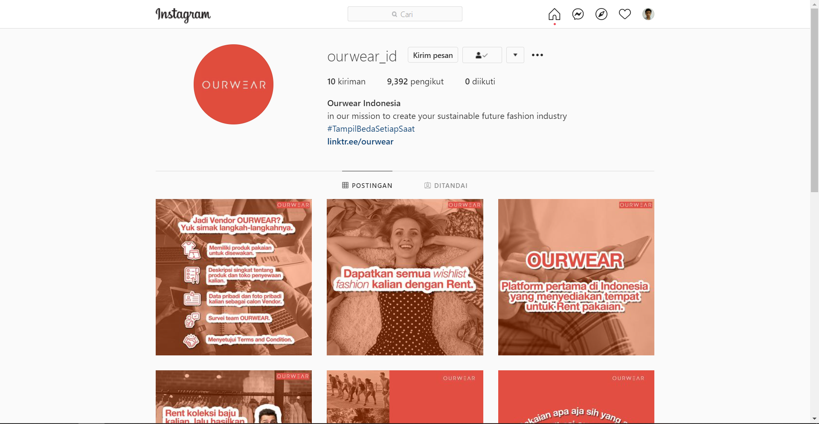
Instagram new post
New instagram post
https://www.instagram.com/ourwear_id/

Slide 4
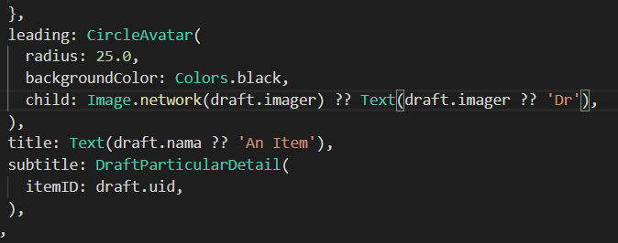
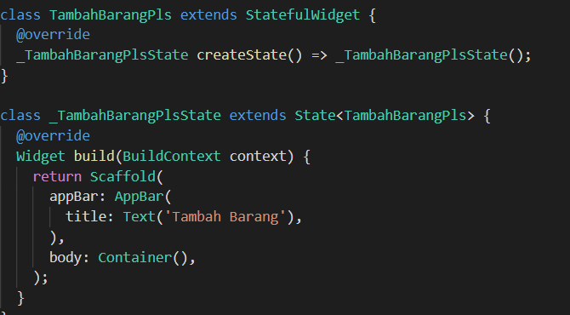
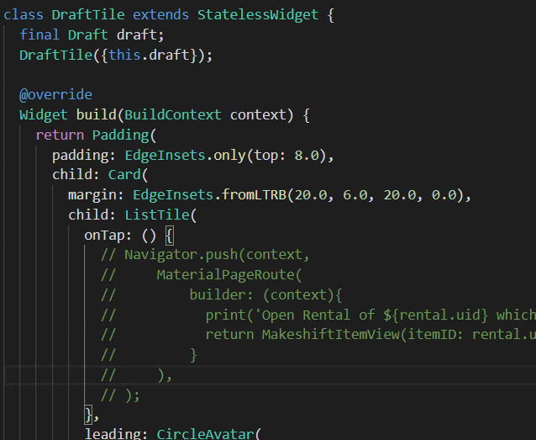
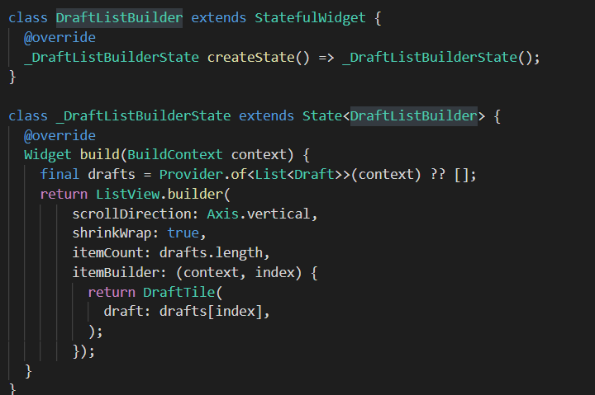
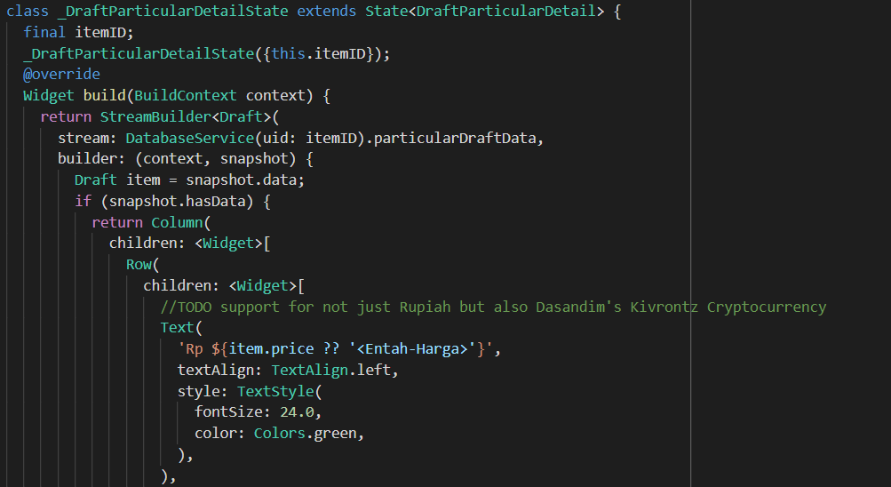
App
Draft add item
Draft list of items in draft
Draft item tile & detail

Slide 5
Doing Trello
Syarat Ketentuan
About Us
Kebijakan Privasi
Quick trade
XD akun
App dev
Feed instagram

Slide 6
To do Trello
Payment
Packaging
Proses Bisnis langganan
Quick rent
Copywriting
Vendor clothing & Laundry
Chip & Scanner tracking
XD penarikan saldo
XD tukar tambah uang dalam trade

